Slide 1

Project 1024 A

Slide 2
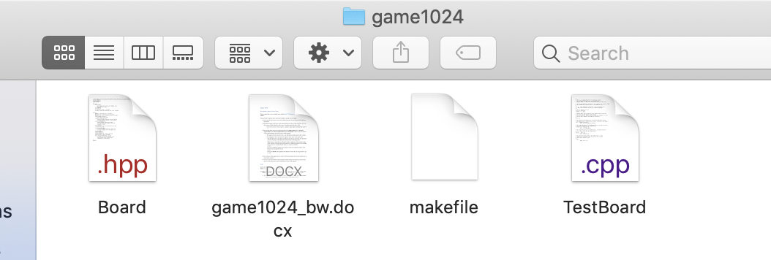
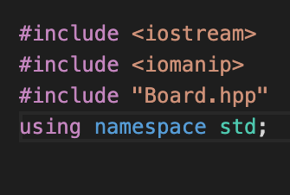
Before anything, create a folder (call it what you’d like), download all parts of the project into said folder and use your terminal to navigate into the folder(/directory). * Hint: Use the CD command to go into a directory (cd myFolder), and to list everything in your current directory use DIR on your Windows computer or LS on your Mac. Make sure you’re able to do this so that you can run your program as instructed at a later point.
Inside of your project folder, create a file called Board.cpp.
Make sure you include the Board.hpp header file towards the top of your Board.cpp file! Your imported libraries should look like this.

Slide 3
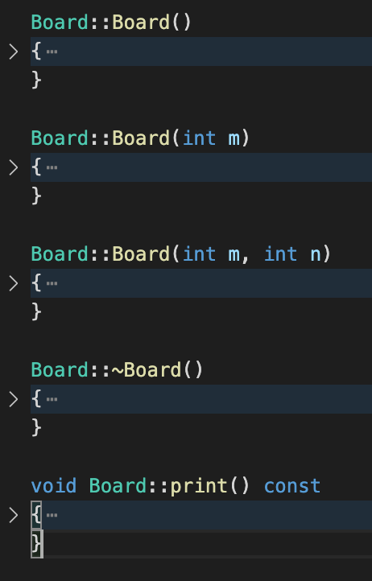
Take a look at your Board.hpp file. You can see that the Board class is defined here and see the default constructor (the one with no parameters), a constructor with one parameter, another constructor with two parameters, a destructor (the method with the ~ at the front of it), a print method, and much more are all being declared.
Write up your constructors, destructor and print methods in your Board.cpp file! Follow the instructions given to you in the game1024_bw.docx file. Please read the ENTIRE document before getting started. Remember that Board:: represents the class that these methods belong to, which we need to define here in our case because the Board class is being declared separately in the Board.hpp file. You’ll need to adjust the TestBoard.cpp file in order to test the various methods on Board.cpp that you are now writing. Then, you can navigate into your project folder (like in our very first step on the previous slide!) and run everything as instructed in the game1024_bw.docx file.
Your Board.cpp file will already consider numrows, target, max, the panel array, etc. all declared because they are defined in the Board class in the Board.hpp file. Use this knowledge to complete the given tasks!

Slide 4
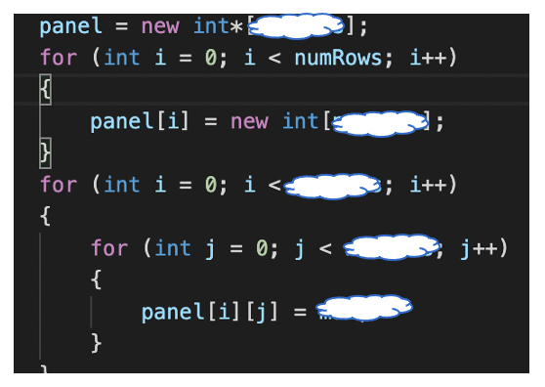
Hint for Panels Array:

Slide 5
Hint for Destructor Method:
Don’t forget to set each item in the panel array to nullptr after using the delete[] keyword on it!
After doing this to each item, you can do the same to the array itself.

Slide 6
Hint for Print Method:
Check out the game1024_bw.docx document and look at the examples. Try to emulate these
boards. Consider using a nested for loop. You can determine whether your current index is even or
odd by using something like i % 2 == 0 (in this case, if this statement were true, i would be even
because the remainder of i divided by two is zero.)

Slide 7
Good Luck!

